Slide 1
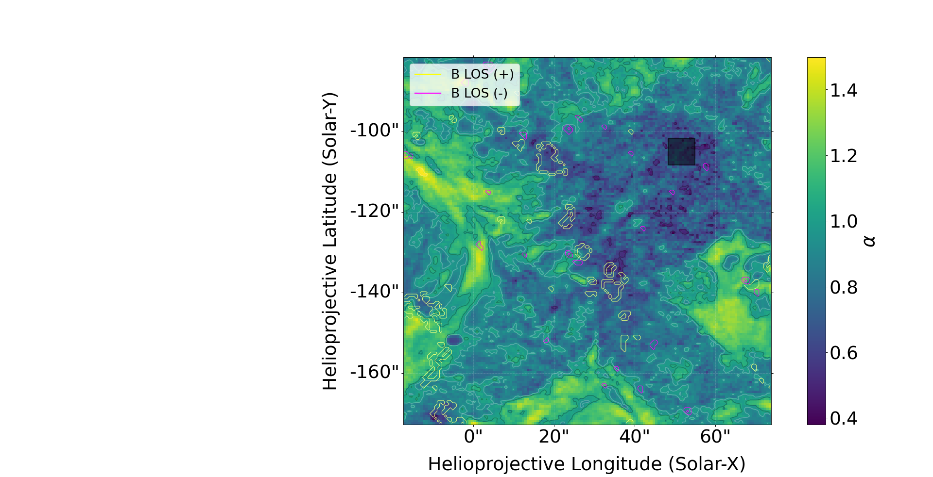
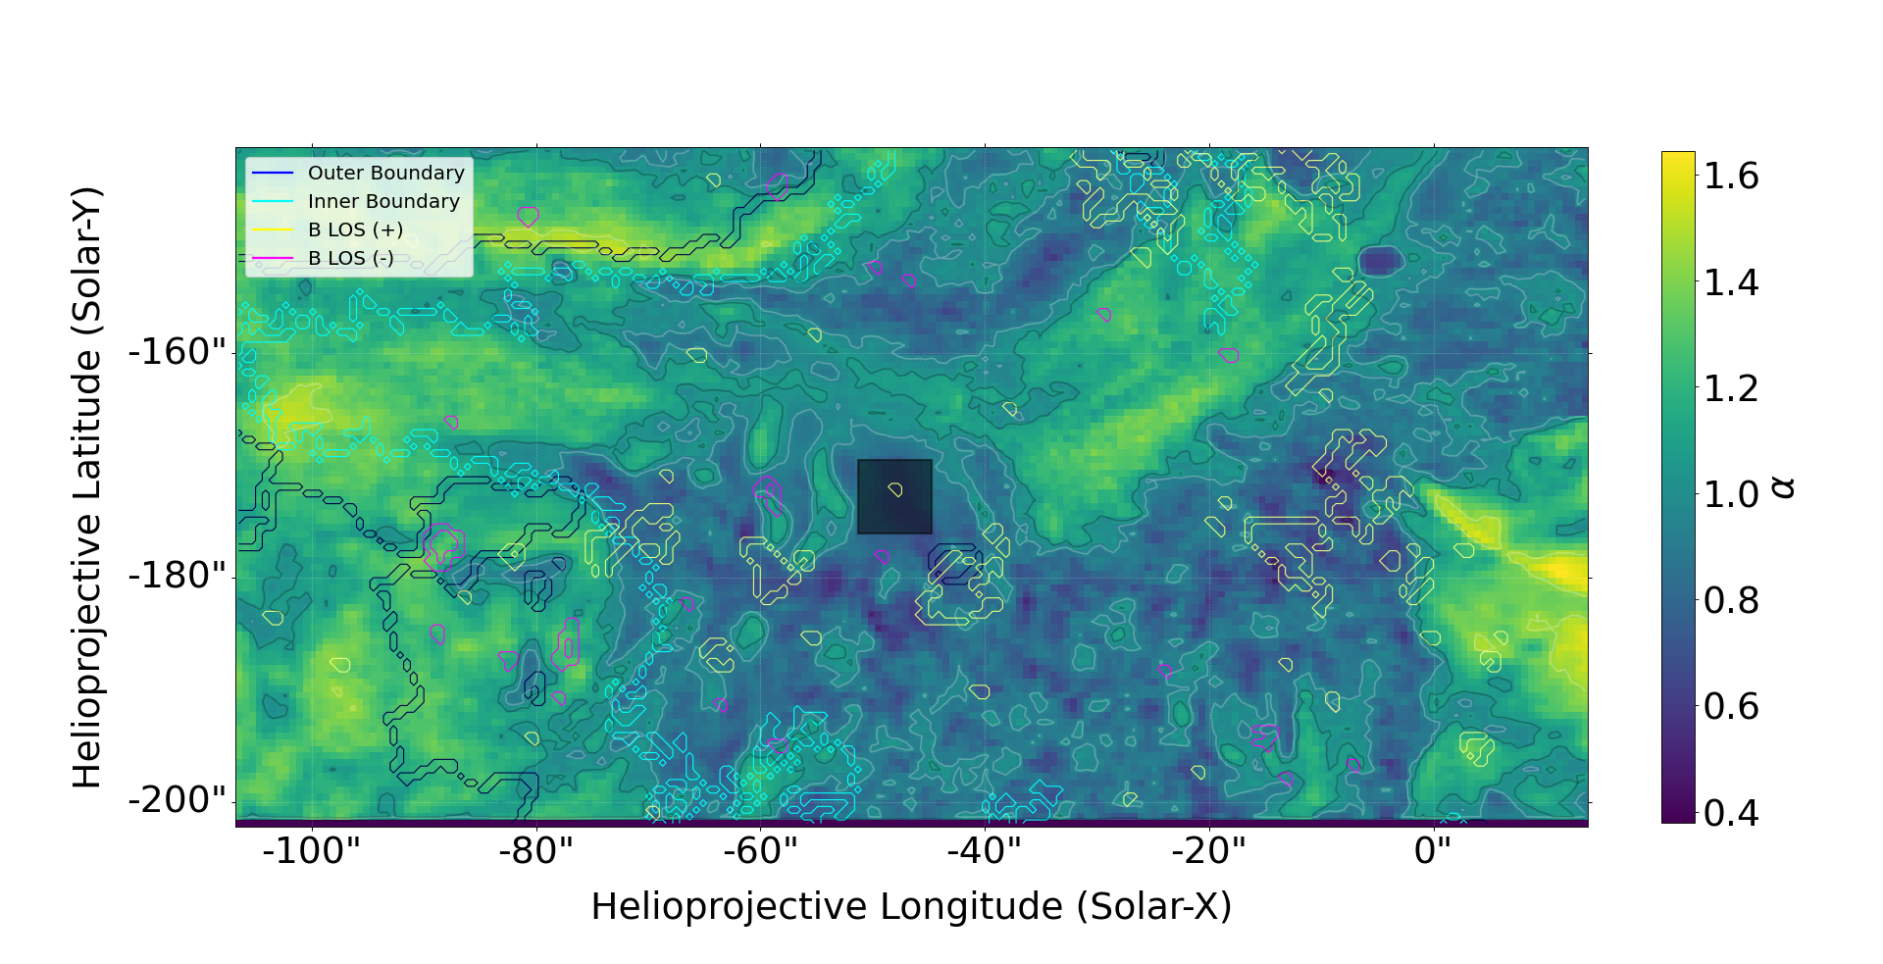
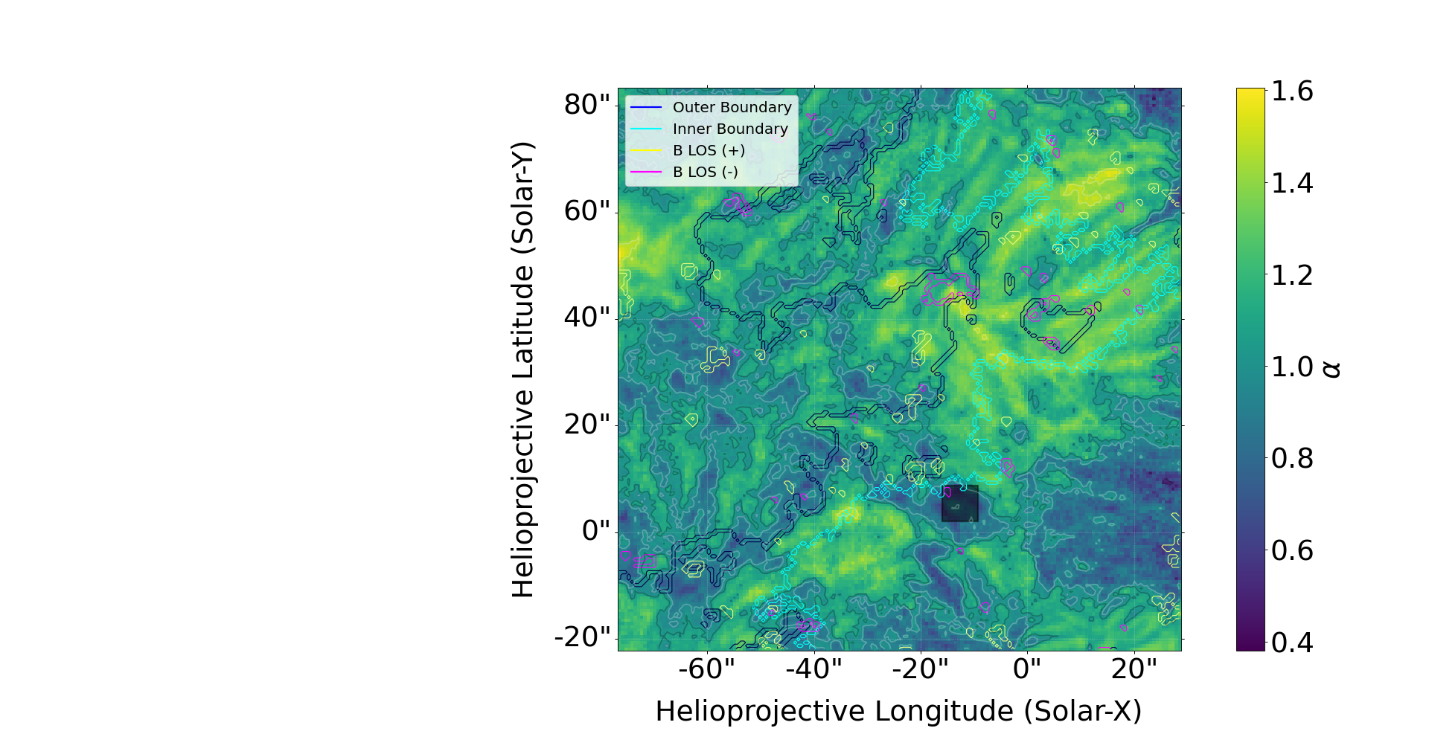
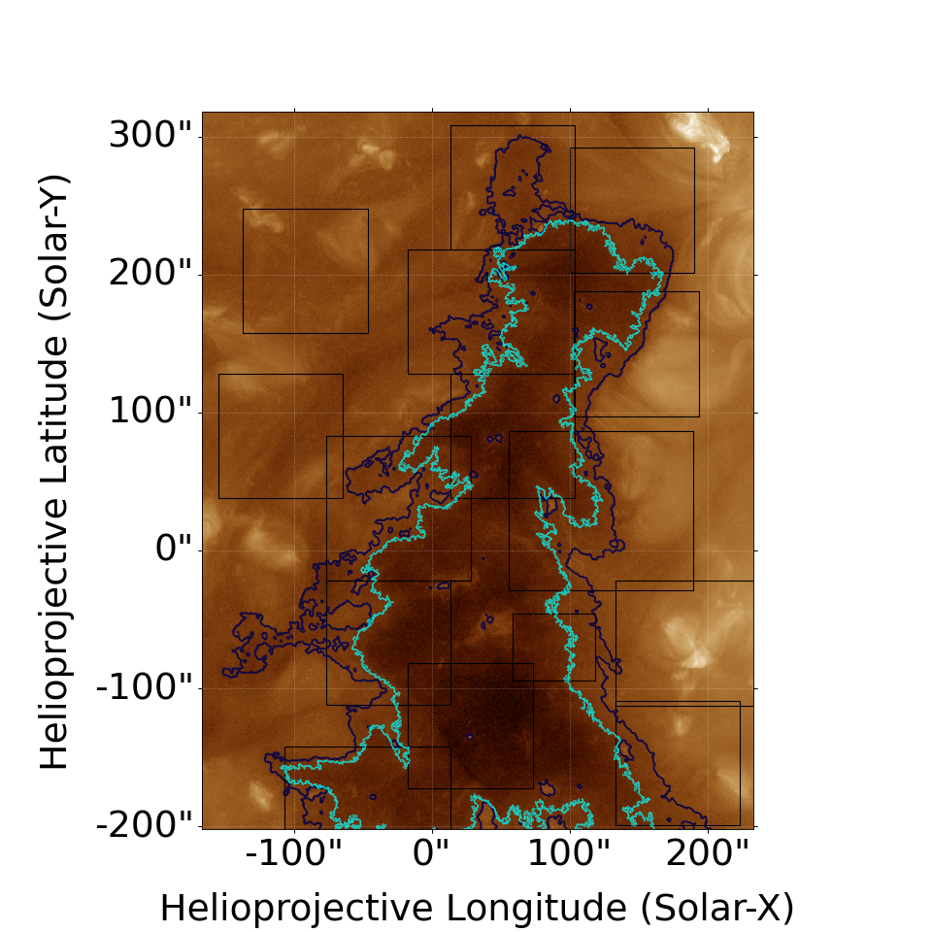
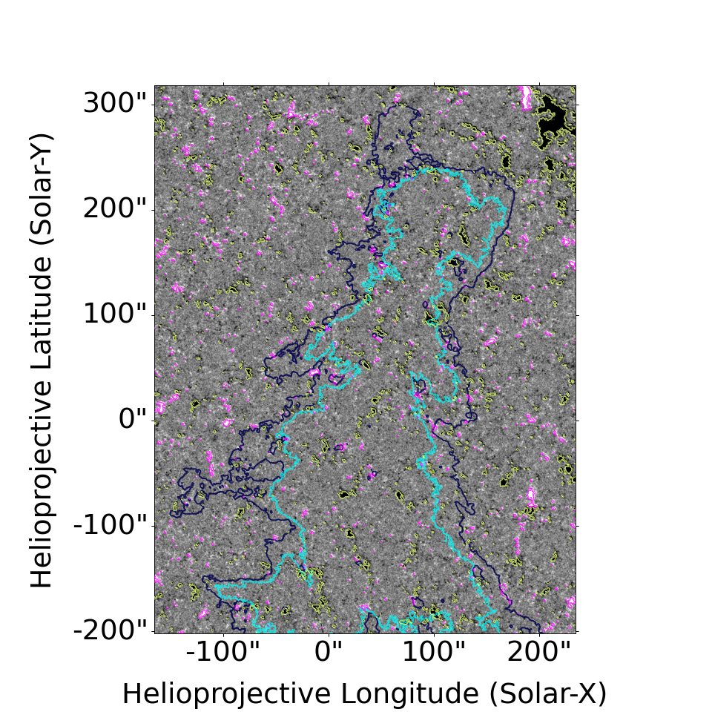
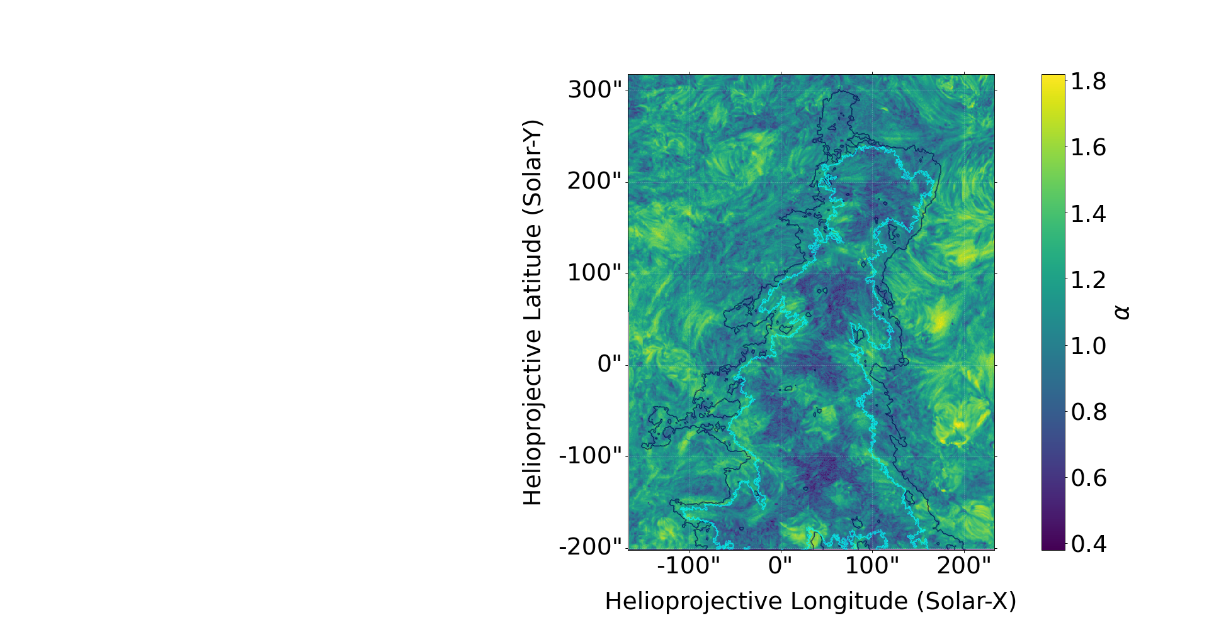
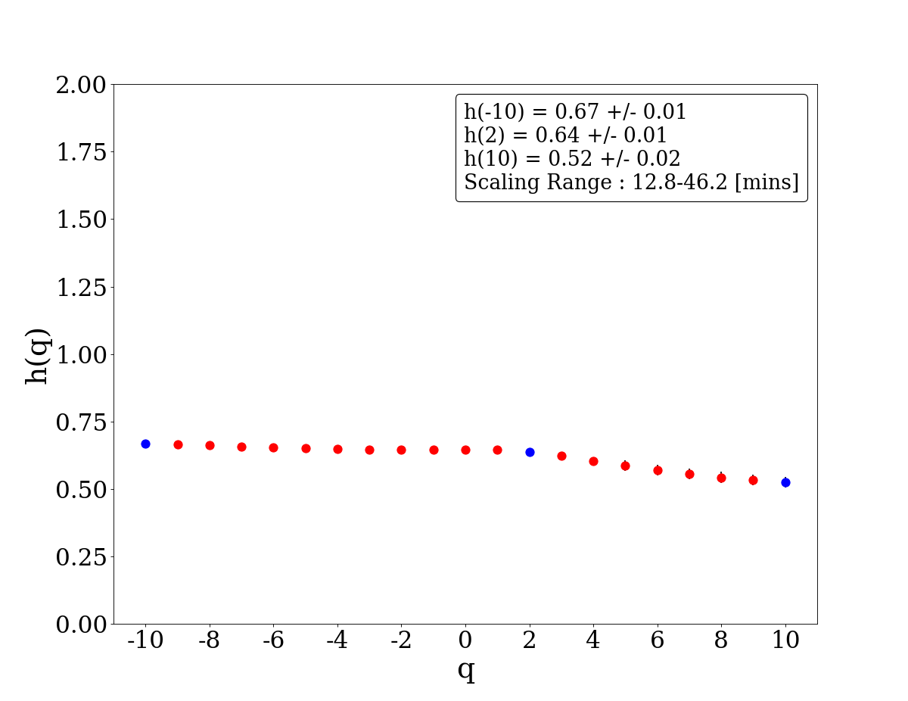
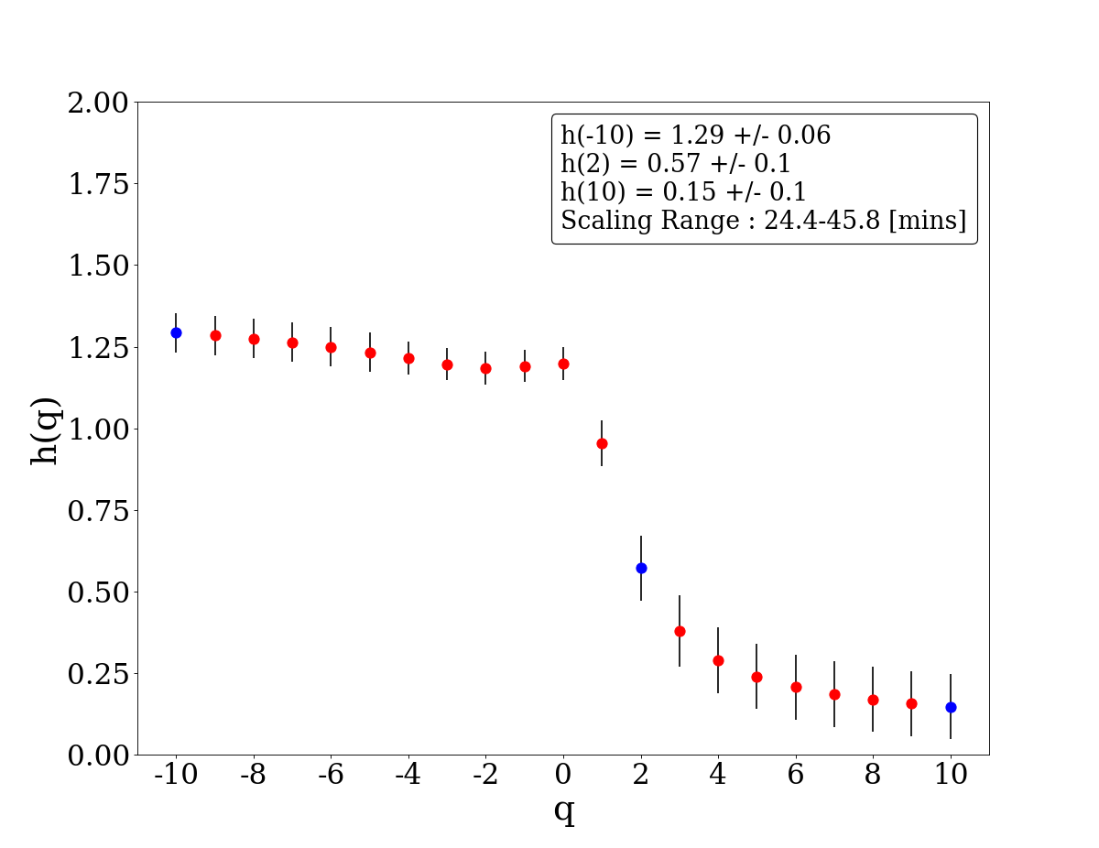
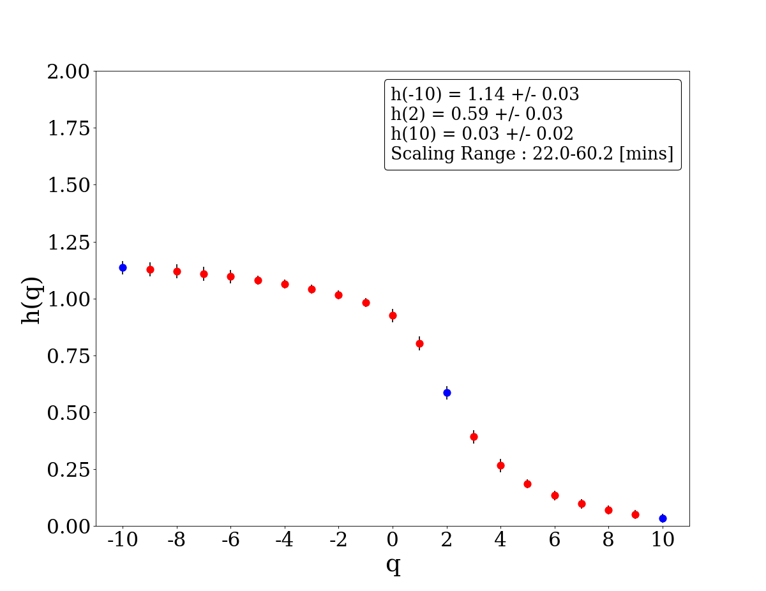
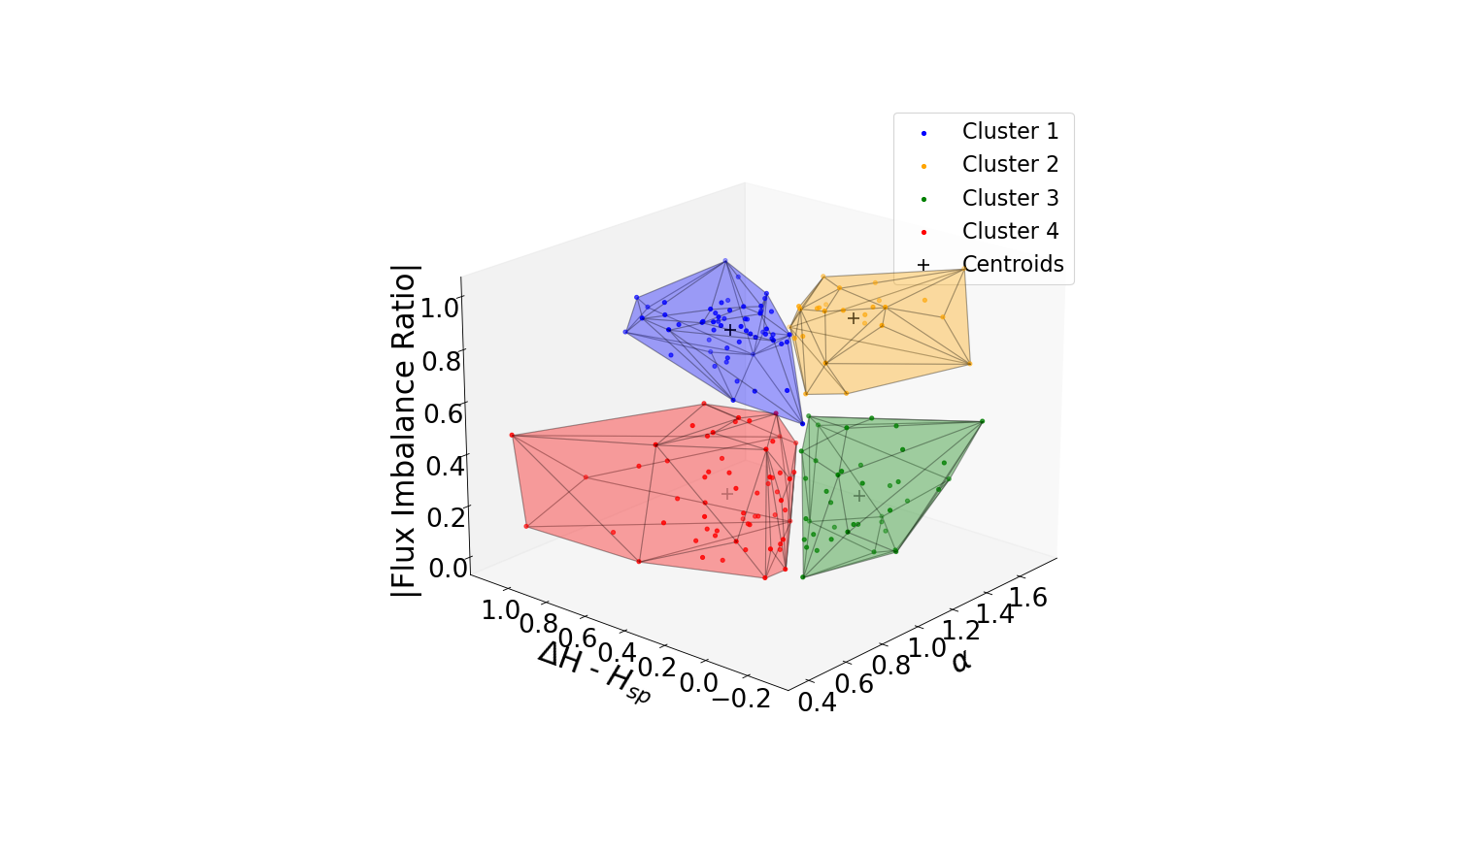
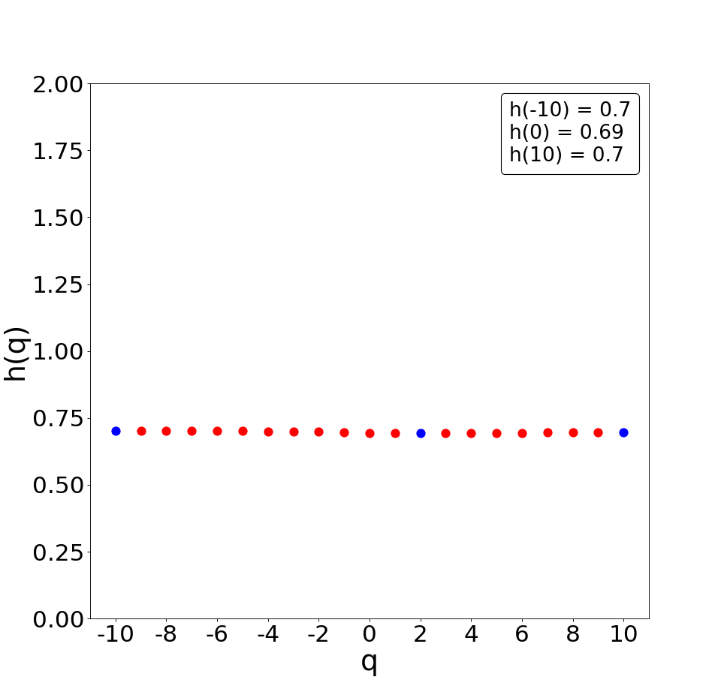
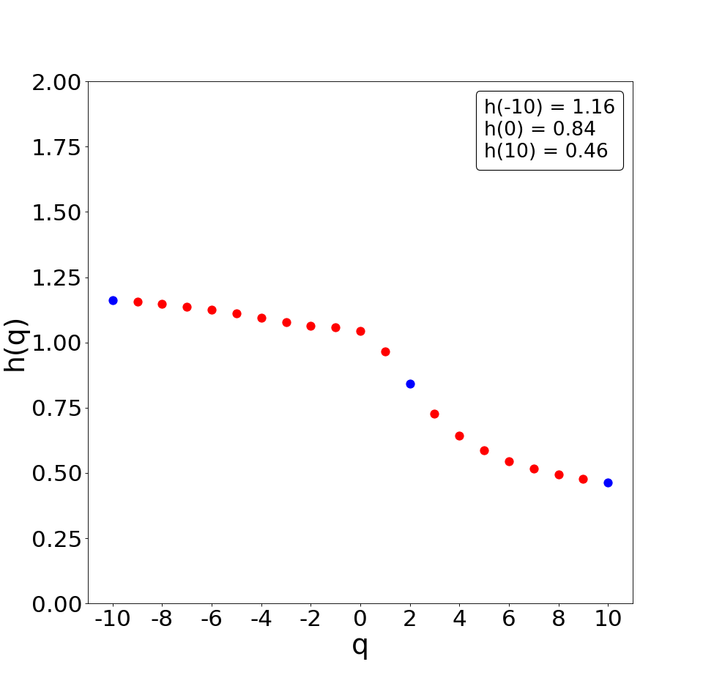
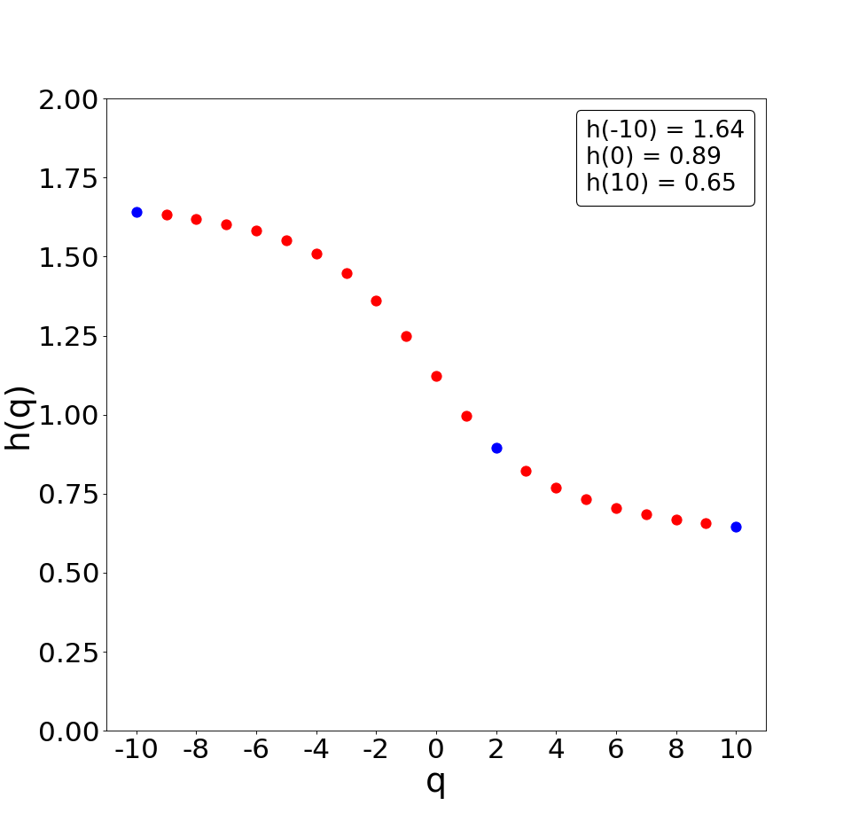
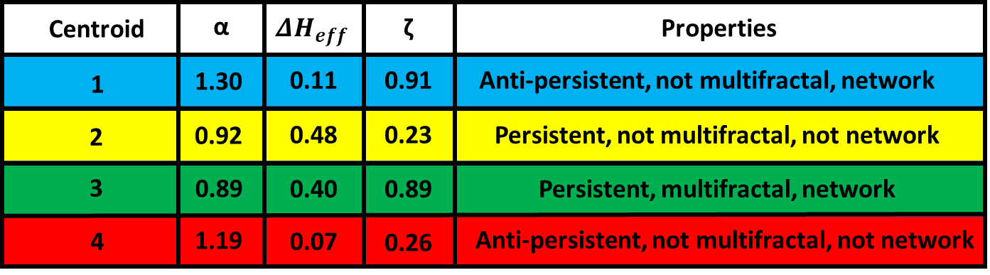
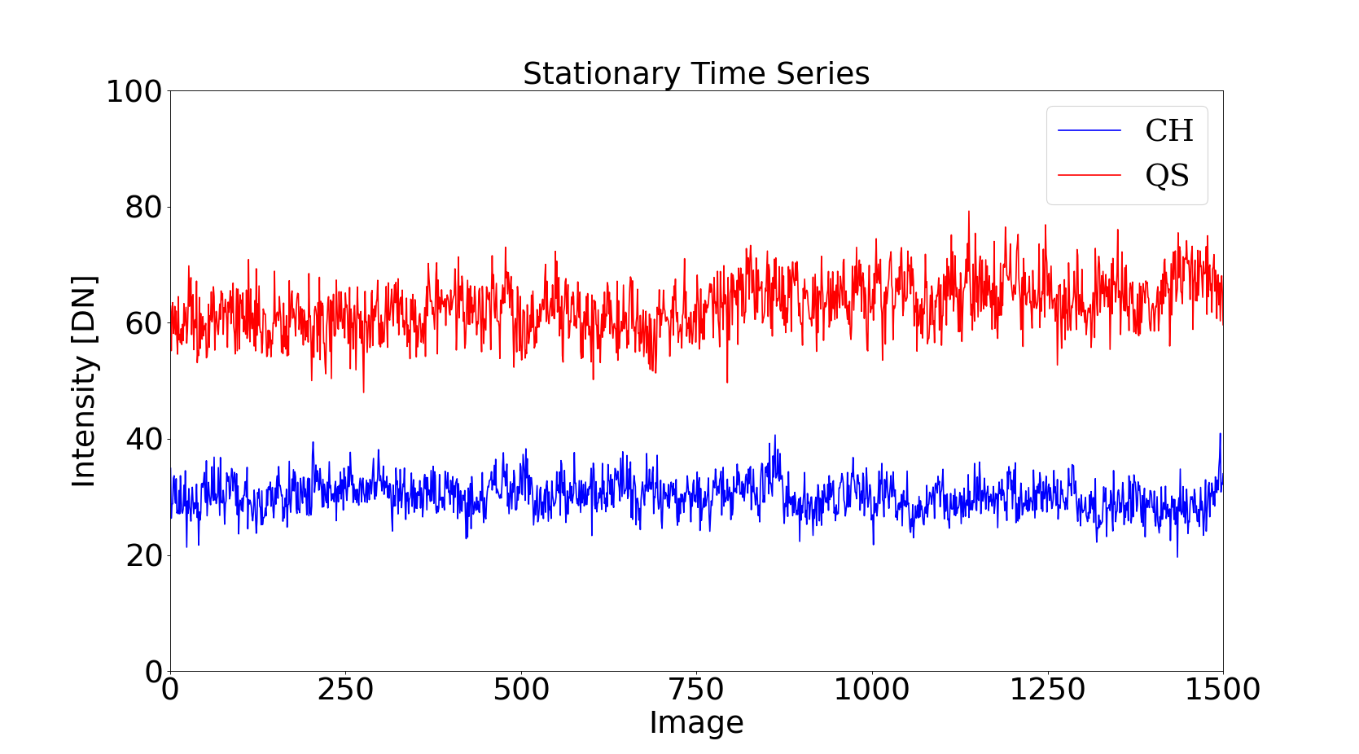
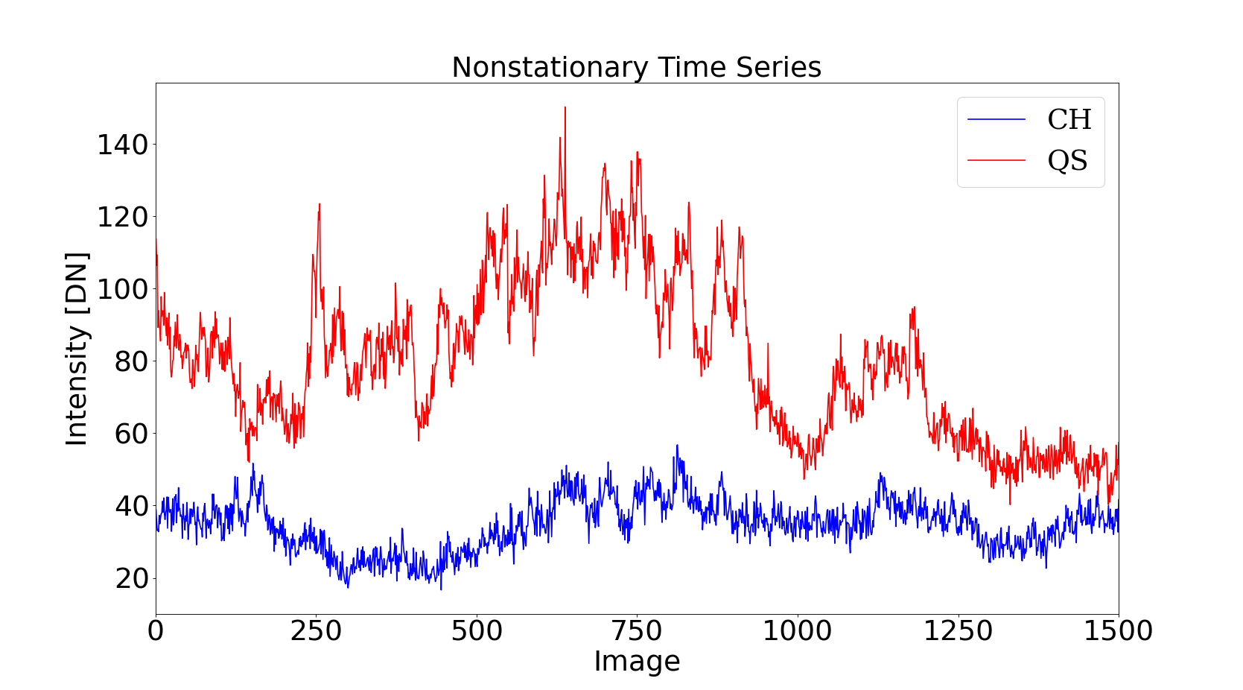




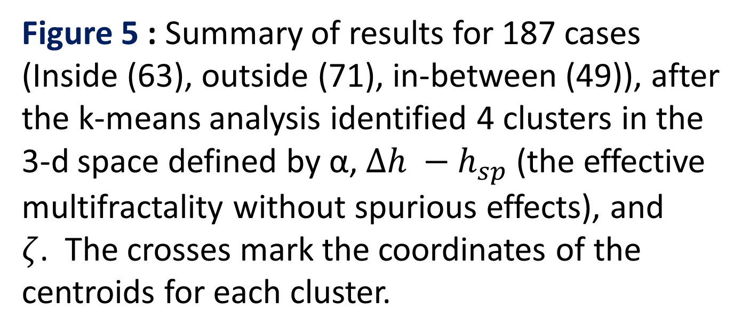
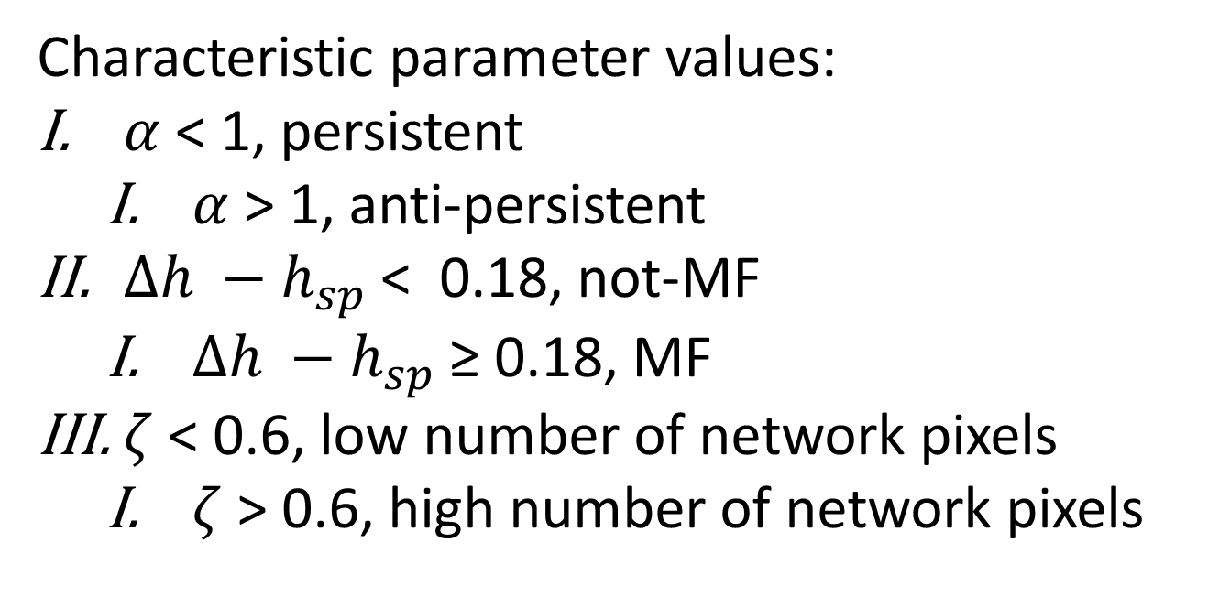
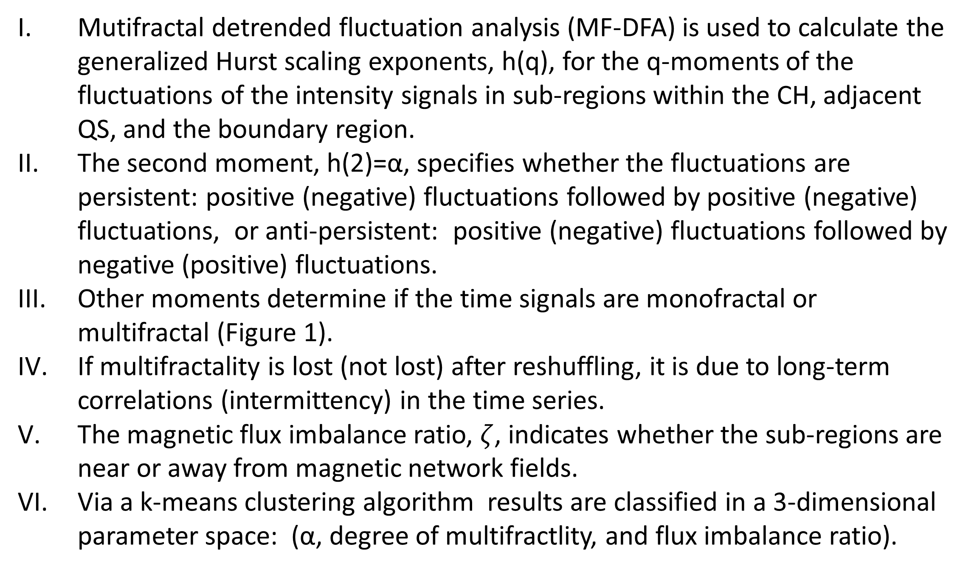
Multifractal Properties of Intensity Signals in Solar Coronal Holes, Adjacent Quiet Sun, and Boundary Regions in the Context of the Magnetic Network
Landon Wells¹, Ana Cristina Cadavid¹, Mari Paz Miralles²
1. California State University Northridge
2. Center for Astrophysics | Harvard & Smithsonian
Inside Region Cluster Number :
[3 0 0 0 3 2 2 0 0 3 2 3 0 0 3 3 0 0 0 3 2 0 3 0 0 2 3 1 2 0 3 0 2 0 0 0 2
2 0 3 0 3 1 2 3 0 3 3 0 3 3 0 3 3 0 3 3 3 3 3 3 1 0 0]
Outside Region Cluster Number :
[1 1 0 2 3 3 0 2 0 3 1 2 1 0 0 0 3 0 1 2 1 0 1 1 2 1 0 1 3 0 3 2 3 2 0 0 2
1 2 3 3 0 2 0 2 2 1 2 1 2 3 1 2 3 1 0 0 1 3 0 0 0 0 3 3 3 3 0 3 0 1 3 0]
Inbetween Region Cluster Number :
[3 2 1 0 1 0 3 2 3 1 3 3 0 3 3 2 1 2 3 0 3 2 2 2 0 0 3 0 3 3 2 1 0 0 3 3 1
2 3 2 2 2 0 2 3 2 3 3 2 2]
The centroids of the clusters : [[1.24 0.13384615 0.90316154]
[1.19658537 0.06 0.2542561 ]
[0.92327869 0.47196721 0.24057869]
[0.88152542 0.4159322 0.89164576]]
Background
Data Analysis
Coronal holes (CH), one of the sources of the solar wind, have weaker coronal emission than surrounding quiet-Sun (QS) regions. While the CHs and QS have comparable numbers of small loops, the long loops reaching coronal heights, common in the QS, are rare in CHs where open magnetic field lines allow the outward flow of the plasma [1].
α-maps for the 15 regions in Figure 2-right, together with the network sites in Figure 2-middle, guided the identification of 185 sub-regions (cases) with (10x10) pixels (100 pixels) for implementations of MF-DFA (Figure 2 – left).
Objective
We investigate the differences between CH and adjacent QS, by examining the scaling symmetries of the fluctuations of time series of extreme ultraviolet
(EUV) intensity 19.3nm emission in an equatorial CH, alongside context of the background magnetic field.
Methods
Mutifractal detrended fluctuation analysis (MF-DFA) is used to calculate the generalized Hurst scaling exponents, h(q), for the q-moments of the fluctuations of the intensity signals in sub-regions within the CH, adjacent QS, and the boundary region.
The second moment, h(2)=α, specifies whether the fluctuations are persistent: positive (negative) fluctuations followed by positive (negative) fluctuations, or anti-persistent: positive (negative) fluctuations followed by negative (positive) fluctuations.
Other moments determine if the time signals are monofractal or multifractal (Figure 1).
If multifractality is lost (not lost) after reshuffling, it is due to long-term correlations (intermittency) in the time series.
The magnetic flux imbalance ratio, $ζ$, indicates whether the sub-regions are near or away from magnetic network fields.
Via a k-means clustering algorithm results are classified in a 3-dimensional parameter space: (α, degree of multifractlity, and flux imbalance ratio).
Figure 4 : Top row: α-maps for three selected regions displaying the network pixels and the two CH boundaries. The black grid denotes the sub-regions used in the MF-DFA to calculate the average h(q). Bottom row: h(q) vs q for the sub-regions in the α-maps, corresponding to a monofractal (left), noisy multifractal (middle), multifractal (right) signals.
Figure 2 : Three figures depicting the data before and after analysis. Left : AIA 19.3nm image of the CH used in the creation of the CHIMERA boundary. Fifteen boxes within the figure define the regions used for the MF-DFA analysis. Middle : Contemporaneous LOS HMI image used in the creation of the network boundaries, where network boundaries are defined for fields with |magnetic density| > 33 G. Right : Unscaled α map created via the DFA.
Results
Figure 5 : Summary of results for 187 cases
(Inside (63), outside (71), in-between (49)), after the k-means analysis identified 4 clusters in the 3-d space defined by α, $∆h −h_{sp}$ (the effective multifractality without spurious effects), and $ζ$. The crosses mark the coordinates of the centroids for each cluster.
Data
Data cube consists of 5 hours (1500 temporal pixels) of SDO/AIA 19.3 nm intensity images of a CH centered at (33.4", 57.97") with a field of view of (400", 520"), observed on 04/16/2017 starting at 12:00:00 (Figure 2 - left).
Contemporaneous coaligned SDO/HMI images provide the magnetic context (Figure 2 - middle).
Images are denoised using the BM3D algorithm following variance stabilization [2].
The CH boundary is defined via the CHIMERA method [3] and via a simple threshold technique, defining the “in-between” region.
Characteristic parameter values:
$α$ < 1, persistent
$α$ > 1, anti-persistent
$∆h −h_{sp}$ < 0.18, not-MF
$∆h −h_{sp}$ ≥ 0.18, MF
$ζ$ < 0.6, low number of network pixels
$ζ$ > 0.6, high number of network pixels
Figure 1 : Simulated curves of h(q) vs q for characteristic time signals.
Left: monofractal (h(q) = α). The small deviation results from a “spurious multifractality” due to the finite length of the time series. Middle: noisy-multifractal, in which noise noticeably affect the negative moments. Right: multifractal, with degree of multifractality (ΔH=h(-10) - h(10)).
Discussion
Figure 3 : Example of intensity time series vs time. Left: stationary and persistent times series (0.5 < α < 1), Right: non-stationary and anti-persistent time series (1 < α < 1.5). α = corresponds to red noise.
Cluster classification favors two main pairings independent of the imbalance ratio: persistent - MF and anti-persistent - not MF.
Statistical analysis indicates that CH cases primarily fall in the first class.
Statistical analysis indicates that QS has comparable percentage of persistent - MF and anti-persistent – MF cases, independent of the imbalance ratio.
Multifractality in persistent - MF cases results from long range correlations.
For some anti-persistent – MF cases, multifractality results from intermittency in the time series.
Denoising leads to better cluster definition. Some noise effects remain, leading to a reduction in the number of cases categorized as multifractal.
Method is successful distinguishing between the CH and QS, while the in-between region presents inconclusive results.
Lack of discrimination according to the imbalance ratio, indicates that the threshold defining network fields must be further explored.
References
Acknowledgements
[1] T. Wiegelmann and S. K. Solanki 2004, Sol. Phys., 225, 227
[2] J. W. Kantelhardt, S. A. Zschiegner, E. Koscielny-Bunde, S. Havlin, A. Bunde, and H. E. Stanley 2002, Physica A, 316, 87
[3] K. Dabov, A. Foi, V. Katkovnik, and K. Egiazarian 2007, IEEE Trans. Image Proc., 16, 2080
[4] M. Makitalo, and A. Foi 2014., IEEE Trans. Image Proc., 23, 5348
[5] T.M. Garton, P.T. Gallagher, and S.A. Murray 2018, JSWSC, 8, A02
This work is supported by NASA grant 80NSSC21K0725 to the Smithsonian Astrophysical Observatory and by a 2020-2021 CSUN Research, Scholarship, and Creative Activity Award.

